Slide 1
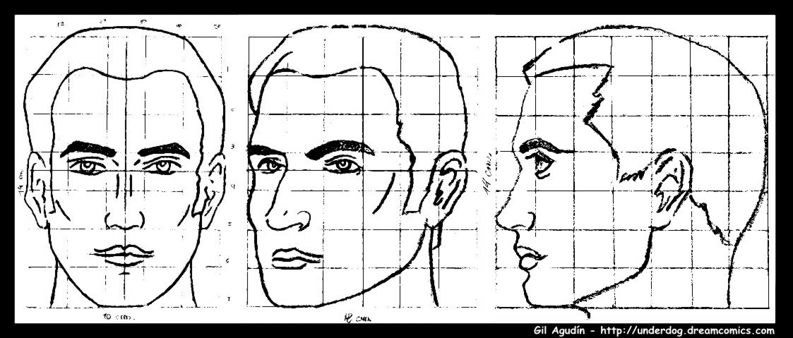
Anatomy of the Face and Head Underlying Facial Expression

Slide 2
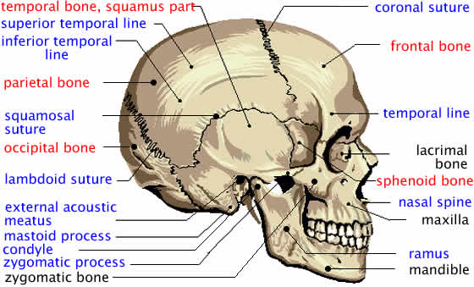
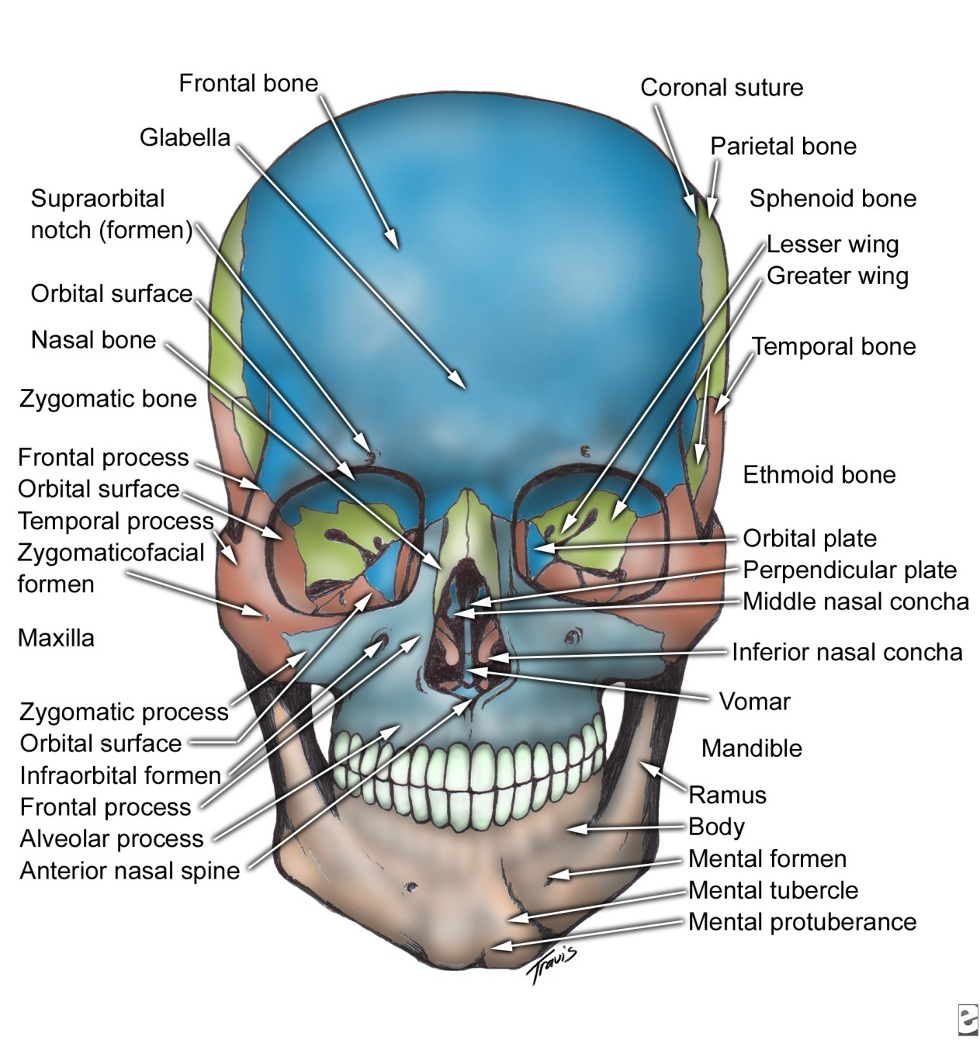
Anatomy of the Human Skull
The human cranium and the facial bones are the foundation for the soft tissues of the face and head. Thus, much of the visible appearance of the human face depends upon the shapes and qualities of these bones.
Notes:
Copy the skull on your sketchbook and copy 3 bones’ names

Slide 3
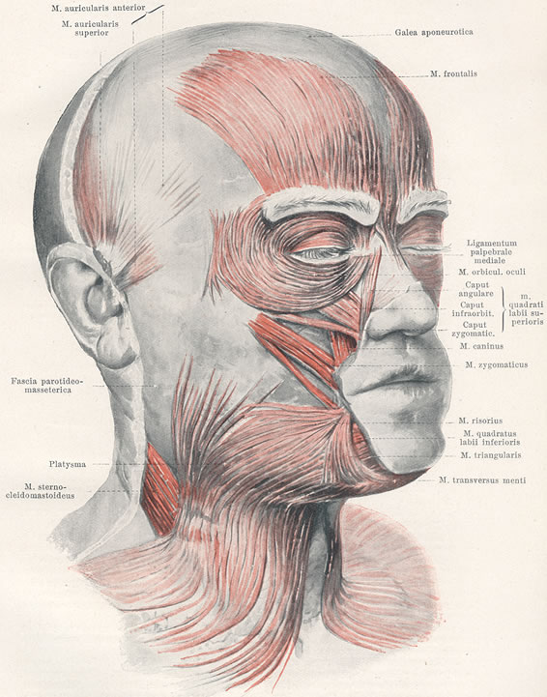
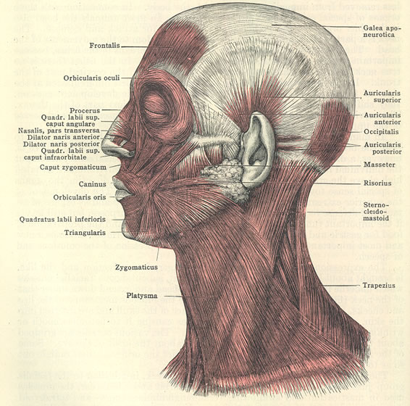
Muscular Anatomy
The anatomy of muscles is most directly related to facial expression, as the muscles underlie these appearance changes.

Slide 4
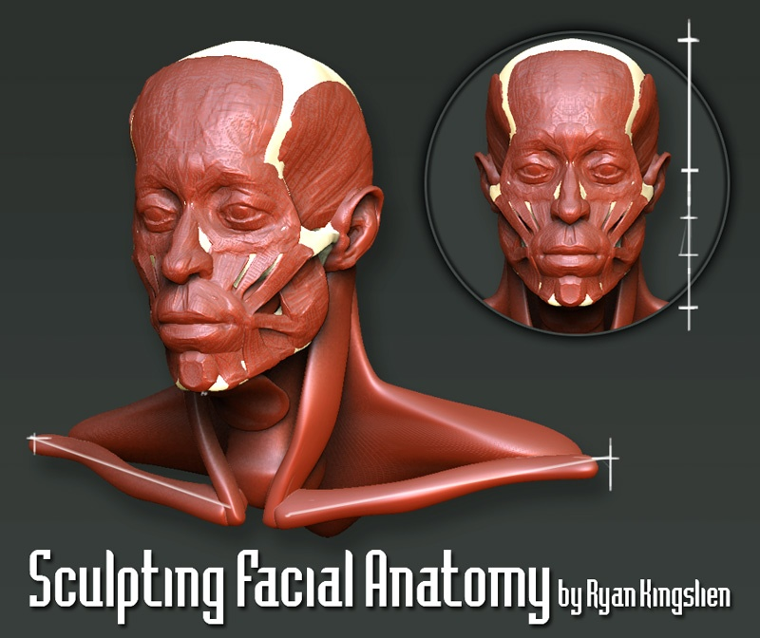
Notes:
Analize Proportions, draw proportion

Slide 5
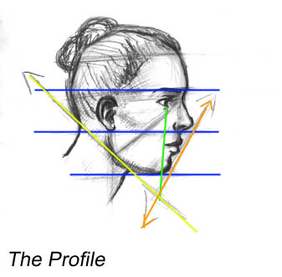
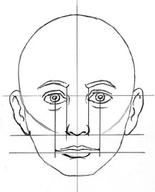
Facial Proportion
Notes:
Copy the face on the right

Slide 6
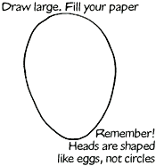
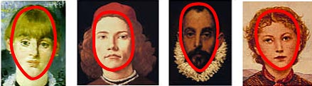
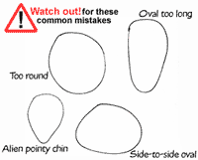
Technique Demonstration:
Face Proportions (Front View)
Face Shapes
Faces are oval or round,egg-shaped, or heart-shaped.
Every face is a little different—look carefully at your model and try to match the shape of the face.
1. HEAD. Draw a large head shape on your paper.

Slide 7
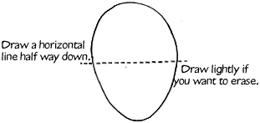
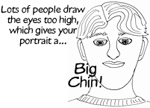
2. EYES. Eyes are halfway down the face. So use your ruler to divide your head in half with a horizontal line. Draw lightly (you may want to erase it later).
This will look a little alien until you add eyebrows and hair. But don't draw the eyes too high!
Notes:
Draw along the suggestions for each slide.

Slide 8
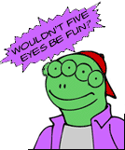
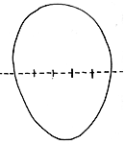
If you look at someone face on, they will have room for five eyes across the front of their face! You can divide the horizontal line into five equal spaces to figure out how big to make the eyes.

Slide 9
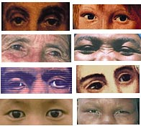
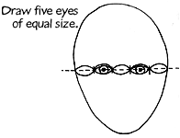
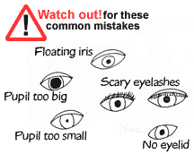
Now draw the eye shapes—you can draw five to start with to help you remember the size and spacing.
Eye Shapes

Slide 10
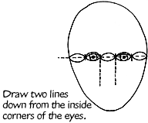
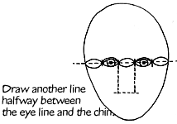
3. NOSE. The size of the nose depends on the person. The bottom of the nose is often as wide as the inside corners of the eyes. So you can draw two lines down from the inside corners of the eyes.
Usually, the bottom of the nose is halfway between the eye line and the bottom of the chin.

Slide 11
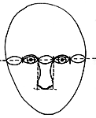
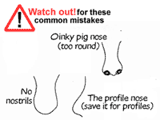
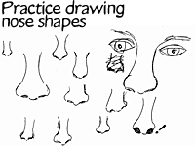
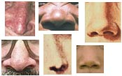
Now you have a "nose box"—draw the nose!
Noses don’t have hard edges or outlines—most of their shape comes from shading. But you can draw simple outlines to practice.
Nose Shapes
Noses take some practice. They come in may different shapes and sizes.

Slide 12
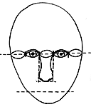
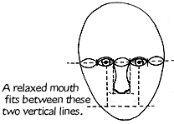
4. MOUTH. Draw another line half way between the nose and the chin.
Mouths are right above this line. The width of the mouth depends on the person’s expression. But the corners of a relaxed mouth line up with the middle of the eye. Draw two vertical lines down from the pupils of the eye.

Slide 13
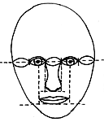

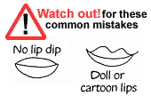
Now draw the mouth!
Mouth Shapes
Mouths tell all! Mouths can tell us how old the model is, whether they are male or female, and what part of the world they came from.
Lip shapes can be made from several curved lines. The bottom lip is usually a little bigger than the top. There is a little dip in the top lip.

Slide 14
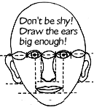
5. EARS. Ears are bigger than many people think! They stretch from the eyes to below the nose. Use the horizontal line you first drew for the eyes to line up the top of the ears. They will end between the bottom of the nose and the mouth.

Slide 15
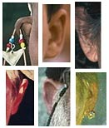
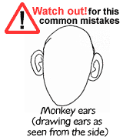
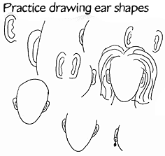
Ear Shapes
You don’t see the entire ear from the front. Ears are often completely hidden by hair, earrings, hats, or wide cheeks.

Slide 16
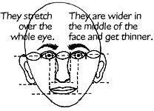
6. EYEBROWS. Eyebrows tell a lot about a person’s mood. They come in all different sizes and shapes (and some people pluck them out!) A gentle arch over the eyes should do for a relaxed face.

Slide 17
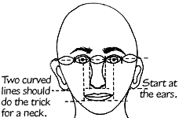
7. NECK. Most people draw the neck too thin. A head weighs eight pounds so necks are big and strong! Start at the ears and gently curve in then out again.

Slide 18
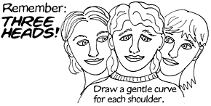
8. SHOULDERS. If you have room on your paper you can draw shoulders or part of the shoulders. We actually have room for three heads on our shoulders!
Make the shoulders wide enough so you could fit another head on each shoulder.

Slide 19
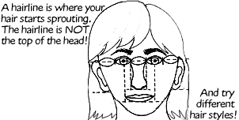
9. HAIR. Last but not least, HAIR! You could stop now if your subject has no hair. But if he or she does, remember where the hairline is.
Good work! Now you can draw front-view portrait! Draw another and another and another until you don’t need to draw the guidelines.

Slide 20
Now is your turn
Homework:
Think what portrait you want to draw.
Write the portrait on a paper.
Turn in to the teacher

